Slide 1

Computer Organization and Architecture Week 3

Slide 2
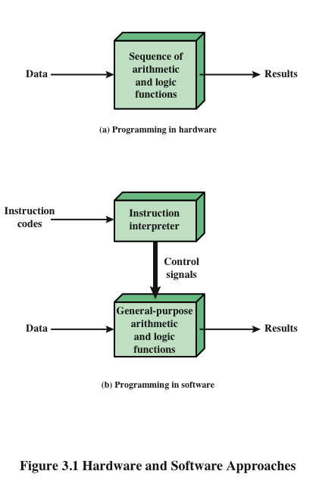
Hardware and Software Approaches

Slide 3
I/O Components
Software
A sequence of codes or instructions
Part of the hardware interprets each instruction and generates control signals
Provide a new sequence of codes for each new program instead of rewiring the hardware
Major components:
Means of reporting results
Output module
Contains basic components for accepting data and instructions and converting them into an internal form of signals usable by the system
Input module
I/O Components
Module of general-purpose arithmetic and logic functions
Instruction interpreter
CPU
Software

Slide 4
MEMORY
Memory address register (MAR)
Specifies the address in memory for the next read or write
Memory buffer register (MBR)
Contains the data to be written into memory or receives the data read from memory
I/O address register (I/OAR)
Specifies a particular I/O device
I/O buffer register (I/OBR)
Used for the exchange of data between an I/O module and the CPU
MAR
MBR

Slide 5
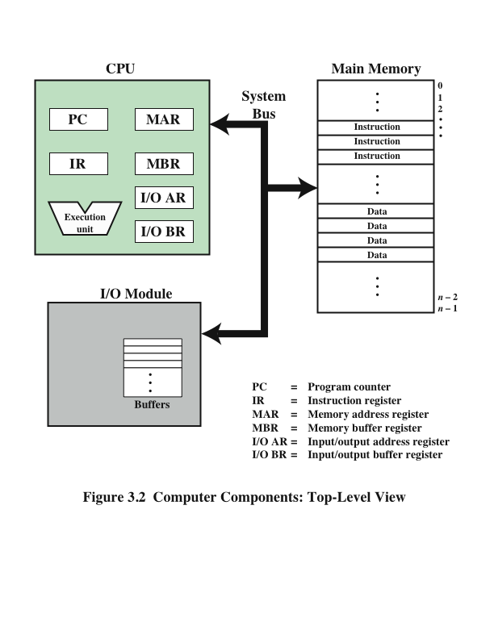
Computer Components: Top Level View
A memory module consists of a set of locations, defined by sequentially numbered addresses. Each location contains a binary number that can be interpreted as either an instruction or data. An I/O module transfers data from external devices to CPU and memory, and vice versa. It contains internal buffers for temporarily holding these data until they can be sent on.

Slide 6
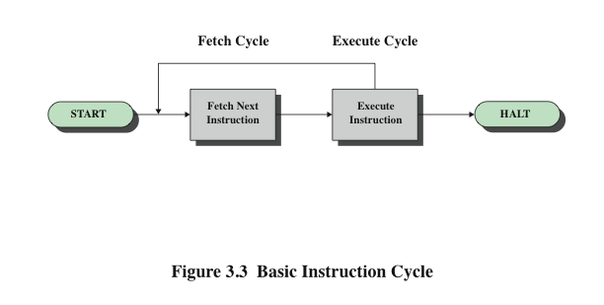
Basic Instruction Cycle
Program execution halts only if the machine is turned off, some sort of unrecoverable error occurs, or a program instruction that halts the computer is encountered.

Slide 7
Fetch Cycle
At the beginning of each instruction cycle the processor fetches an instruction from memory
The program counter (PC) holds the address of the instruction to be fetched next
The processor increments the PC after each instruction fetch so that it will fetch the next instruction in sequence
The fetched instruction is loaded into the instruction register (IR)
The processor interprets the instruction and performs the required action

Slide 8
Action Categories
Processor-memory
Data transferred from processor to memory or from memory to processor
Processor-I/O
Data transferred to or from a peripheral device by transferring between the processor and an I/O module
Data processing
The processor may perform some arithmetic or logic operation on data
Control
An instruction may specify that the sequence of execution be altered

Slide 9
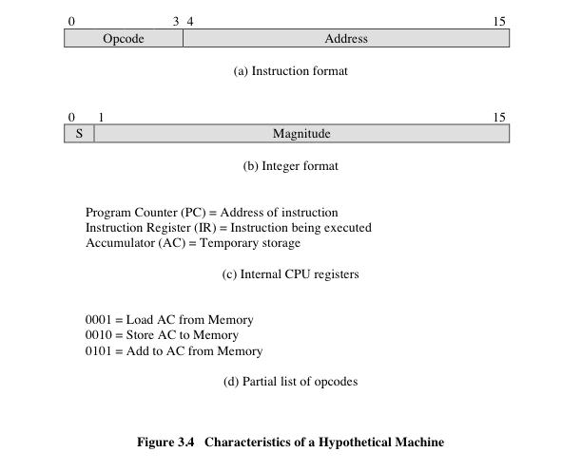
Consider a simple example using a hypothetical machine that includes the characteristics listed in Figure 3.4. The processor contains a single data register, called an accumulator (AC). Both instructions and data are 16 bits long. Thus, it is convenient to organize memory using 16-bit words.

